Slide 1

Using CHIRPS Rainfall Data & American Community Survey Data to Model Climate Gentrification
Evan Shapiro
CU Denver - Applied Mathematics & Statistics
Notes:
Hi there, My name is Evan Shapiro, and I am a graduate student of applied mathematics at CU Denver. I will be presenting my final project for Bayesian Statistics: Using CHIRPS Rainfall Index Data & American Community Survey Data to Model Climate Gentrification

Slide 2
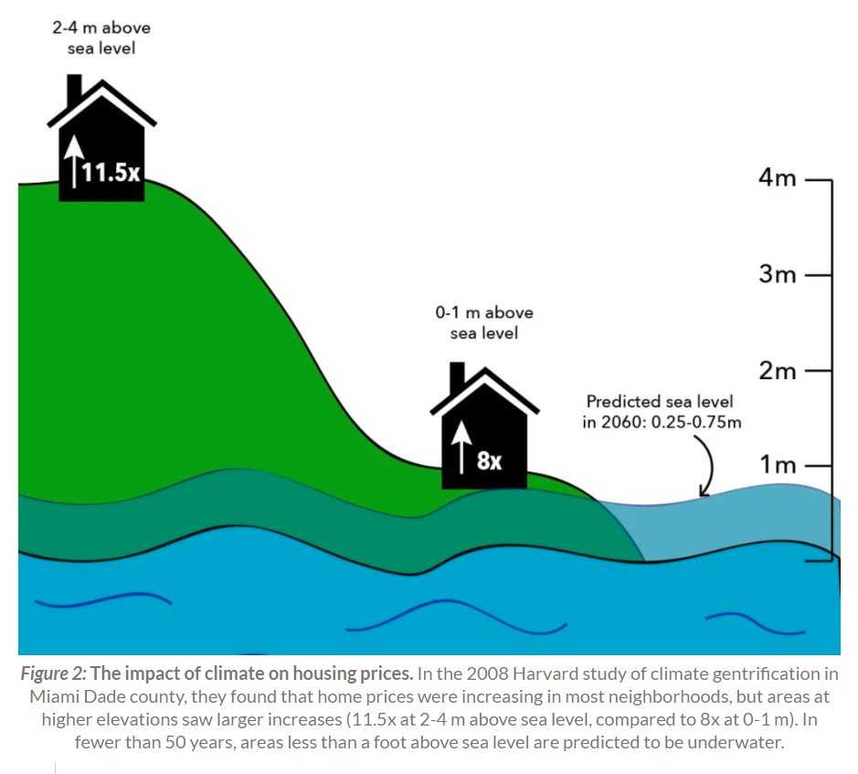
Climate Gentrification
Gentrification is the process of changing the character of a neighborhood through the influx of more affluent residents and businesses.
Climate gentrification occurs when these communities become more valuable due to geographic or engineered properties that insulate the communities from local or global impacts of climate change.
Climate Gentrification Study – Miami Dade County
Incremental Increases In Elevation Lead to Increase in Positive Change in Property Value
Previously “inferior” area becomes “superior”, leading to increase if property values.
Image Source: http://sitn.hms.harvard.edu/flash/2019/climate-newest-gentrifying-force-effects-already-re-shaping-cities/
Notes:
Gentrification is the process of changing the character of a neighborhood through the influx of more affluent residents and businesses. Climate gentrification occurs when these communities become desirable due to thee geographic or engineered properties that insulate the area from extreme weather events. A study published in 20018 showed that climate gentrification is already occurring in in Miami Dade County, Florida. In MDC, gravity is used for flood management, so areas at higher elevations have decreased flood risk, which is becoming more valuable as sea-levels rise. The study tested and validated the hypothesis that "the rate of price appreciation of single-family properties in MDC is positively related to and correlated with incremental measures of higher elevation."

Slide 3

Hypothesis to Test: Is Climate Gentrification Occurring in CO?
Colorado wildfire season is getting longer, and affecting more areas. In CO, gentrification could occur as people living in areas with a high fire risk are forced to move to lower risk areas.
Can a relationship be detected between climate variability, time, and changing demographics in 10 Colorado Counties?
Part 1: Use rainfall index data as a proxy for climate change. An increase in maximum consecutive dry days (MLDS) per year can be interpreted as an increase in extreme weather patterns over time. An increase the rain intensity (SDII) is viewed as an effect of climate change.
Part 2: Construct a Bayesian, generalized linear model to detect a relationship between the maximum number of consecutive dry days in a year is linearly related to changing change in time, county, income level, and educational level.
Profit: (Not Really) Policy Recommendation: If a relationship is detected, advise for more research and investment in interventions and mitigation of the effects of gentrification.
Notes:
Due to an increase in wildfire activity climate gentrification could occur in Coa people living in regions with a high wildfire risk are forced to move. In this project I set out to construct a linear model using Bayesian inference to study whether an increase in rainfall intensity, and longer periods of consecutive dry days is related to a change in income demographics and education demographics. Meaning, as a change in climate occurs, as measured through rainfall index data, are populations with lower education or income levels pushed out of their communities. If a negative correlation is detected between income level, education level and the maximum length of the dry day this could provide evidence that climate gentrification is already occurring. Due to the detrimental impact that gentrification has on effected communities, I could recommend that policies be developed to study, understand and mitigate the negative effects of climate gentrification.

Slide 4
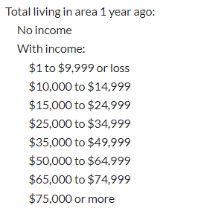
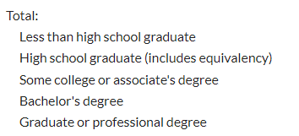
Methodology: American Community Survey Data Collection
ACS Table B07410
County Level
Income Demographics
ACS Table B07009
County Level
Education Demographics
Demographic Data: American Community Survey data- Available in R through the “acs” package.
Collected yearly (2012 – 2019) income and educational demographic data at county level, for 10 counties in CO where ACS survey was administered.
Adams, Arapahoe, Boulder, Denver, Douglas, El Paso, Jefferson, Larimer, Pueblo, Weld
These values are estimates based on data collected by Census bureau. Did not factor uncertainty into the model.
Notes:
The county level income and education demographic data were collected using the American Community Survey API in the R Programming Language.library("acs"). The income demographic data was provided by table B07410, and the education demographics data were collected using table B07009. The American Community Survey is a survey that is administered by the Census Bureau in 1,3, and 5 year time intervals to supplement the decennial census, with data available through the API from 2012-2019. I collected county level data for all available Colorado counties from data tables B07410( Geographical Mobility in the Past Year by Individual Income for Residence 1 Year Ago in the United States), and B07009 ( Geographical Mobility in the Past Year by Educational Attainment for Current Residence in the United States).B07410 provides population data at the county level distributed according to income levels, as seen on the slide.B07009 provides population data at the county level, distributed according to education level. I chose ACS annual data instead of decennial Census data because the ACS data provides 8 annual time points (2012 - 2019) for each county, rather than 3 decennial time points. This makes constructing the construct a a model relating population income and education level to rainfall variability through indexing.

Slide 5
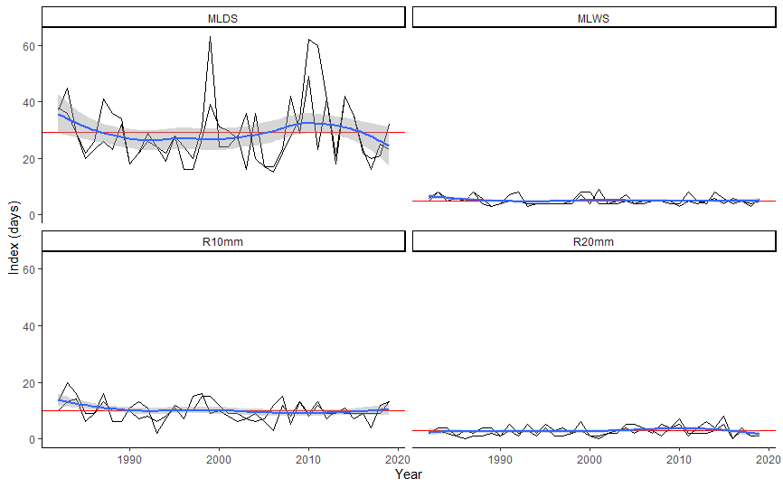
Methodology: CHIRPS Data Collection
Rainfall Data: CHIRPS Rainfall Data – Available in R using the “chirps” package.
Incorporates 0.05 arc-degrees resolution satellite imagery, and in-situ station data to create gridded rainfall time series for trend analysis and seasonal drought monitoring.
Collected annual rainfall index data from same 10 counties in CO from 1982 – 2019 for trend analysis.
Response Data for Model:
MLDS- Maximum Length of Consecutive Dry Days Per Year
SDII – Single Daily Intensity Index Data.
Weld County – Time Series of Yearly Index Values
1982 - 2019
MLDS - Maximum Consecutive Dry Days ,
MLWS - Maximum Consecutive Wet Days,
R10mm – Number of Days With Rain >= 10mm
R20mm – Number of Days With Rain >= 20mm
Notes:
The rainfall index data was collected using the CHIRPS API in the R Programming Language. CHIRPS stands for "Climate Hazards group Infrared Precipitation with Stations", The rainfall indices from the CHIRPS API that I used in this project were the MLDS -The maximum consecutive length of dry day (rain < 1mm) Rtotal -)The Single Daily Intensity Index, which is the total precipitation divided by the number of wet days. CHIRPS rainfall and index data is available on the time scale ranging from 5 days to the entire time period the data has been collected (39 + years ).Using the CHIRPS API, rainfall data was collected in 20 Colorado counties from 1982 - 2019, and then MLDS index data and SDII index data were extracted for modeling and analysis. I chose maximum number of consecutive dry days as the response variable, as this corresponds to an increase of extreme weather events, and is connected to drought conditions, and possibly fire events.

Slide 6


Methodology: Constructing Bayesian Generalized Linear Models-(Rstanarm)
2 Data Sets – MLDS and SDII
Maximum Consecutive Dry Days is Count Data – Use Poisson Model
Note: There are 10 Counties, 5 Educational Levels, and 8 Income Levels.
1 Model – Education, Income
Educational Model:
${ y}_{i,j}=β_{0}+β_{1}year_{i}+β_{2,j}IncPop_{i,j}+ε_{i,j}$,
${ y}_{i,k}=β_{0}+β_{1}year_{i}+β_{3,k}EdPop_{i,k}+ε_{i,,k}$
with $i=1:8, k=1:8, j=1:5,$ and $ε_{i,j,k}∼Poisson\left(λ\right)$ for MLDS data and $ε_{i,j,k}∼N(μ,σ^{2})$ for SDII Data.
${ y}_{i,j,k}$ is the response data in the ith year, at the jth educational level, at the kth income level.
$PopInc_{i,j}$ is the population of people at the jth income level in the ith year.
$EdPop_{i,k}$ is the population of people at the kth educational level in the ith year.
Notes:
I constructed 2 separate linear models, relating index data to time and income demographics in model 1, and to time and education demographics in model 2. I constructed two separate because there must be overlap between and education and income demographics, and I do not have the data necessary to understand that overlap. The intercept values tells us the median maximum consecutive dry day length and simple daily intensity index value across all counties over the 8 year period.
The coefficients for income level population and educational level population can be interpreted as the mean change in the response variable as a change in population occurs at each level.
To model the coefficients I used the rstanarm library in the R Programming language. Rstanarm uses a Bayesian approach to constructing posterior distributions of each of the model coefficients, by using the response data and any prior information we have on the coefficient's distribution.

Slide 7
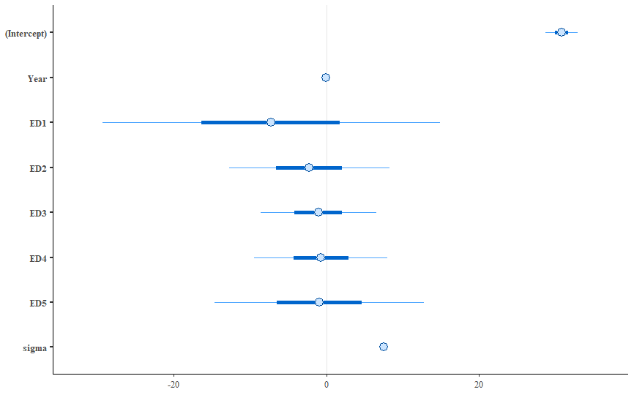
MLDS Educational Model Posterior Results
Posterior Interval Estimates For MLDS Educational Parameters
SDII Education Model |  | Median | MAD_SD
Intercept |  | 30.8 | 1.3
Year |  | -0.1 | 0.2
Education Level 1 |  | -7.2 | 13.4
Education Level 2 |  | -2.3 | 6.4
Education Level 3 |  | -1 | 4.6
Education Level 4 |  | -0.7 | 5.3
Education Level 4 |  | -0.9 | 8.3
sigma |  | 7.5 | 0.3
Notes:
Here are the results for the coefficients of the linear model for Maximum Consecutive Dry Day Education model. The parameters have variance much larger than the parameters, making any sort of conclusion impossible. I think the large variance is due in part to a model construction issue

Slide 8
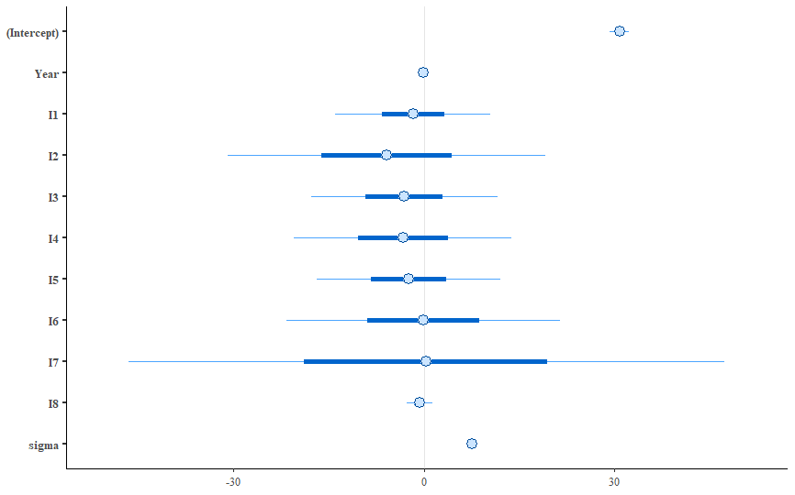
MLDS-Income Model Posterior Results
Posterior Interval Estimates For SDII-Income Parameters
MLDS Income Model |  | Median | MAD_SD
Intercept |  | 30.8 | 0.9
Year |  | -0.1 | 0.1
Income Level 1 |  | -1.7 | 7.4
Income Level 2 |  | -5.9 | 15.2
Income Level 3 |  | -3.1 | 9
Income Level 4 |  | -3.3 | 10.4
Income Level 5 |  | -2.4 | 8.8
Income Level 6 |  | -0.1 | 13.1
Income Level 7 |  | 0.4 | 28.4
Income Level 8 |  | -0.7 | 1.2
sigma |  | 7.5 | 0.2

Slide 9
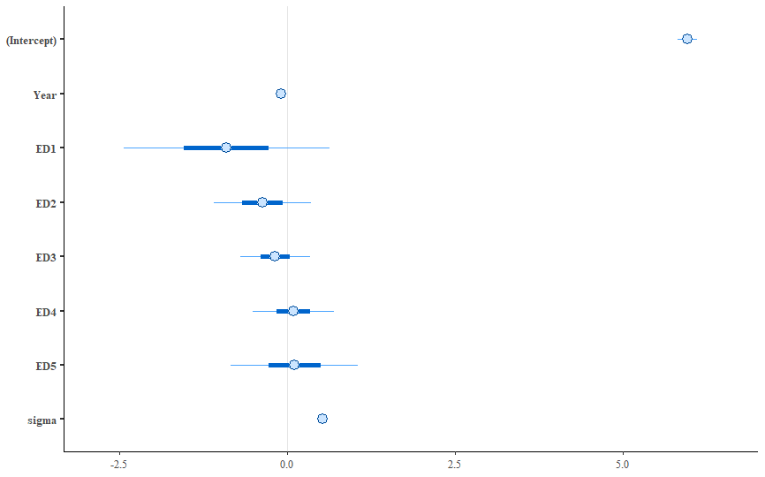
SDII-Education Model Posterior Results
Posterior Interval Estimates For SDII Educational Parameters
SDII Education Model | Median | MAD_SD
Intercept | 6 | 0.1
Year | -0.1 | 0
Education Level 1 | -0.9 | 0.9
Education Level 2 | -0.4 | 0.4
Education Level 3 | -0.2 | 0.3
Education Level 4 | 0.1 | 0.4
Education Level 5 | 0.1 | 0.6
sigma | 0.5 | 0
Notes:
The Simple Daily Intensity Index model results, show a weak correlation to income levels 1-5, and 8, and educational levels 1 and 2. The parameter values are all negative and getting smaller as the level increases. If the parameters are not junk or noise, this could indicate that in urban areas populations of people with lower educational and income levels decrease as rain intensity increases

Slide 10
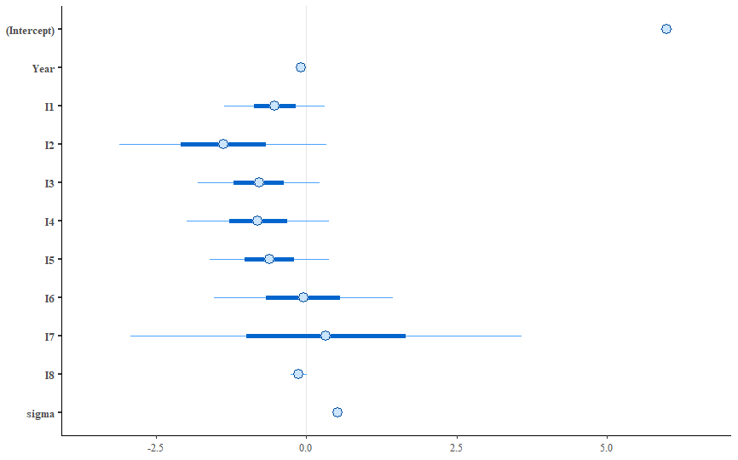
SDII-Income Model Posterior Results
Posterior Interval Estimates For SDII-Income Parameters
SDII Income Model | Median | MAD_SD
Intercept | 6 | 1
Year | -0.1 | 0
Income Level 1 | -0.55 | 0.5
Income Level 2 | -1.4 | 1
Income Level 3 | -0.8 | 0.6
Income Level 4 | -0.8 | 0.7
Income Level 5 | -0.6 | 0.6
Income Level 6 | -0.1 | 0.9
Income Level 7 | 0.3 | 2
Income Level 8 | -0.1 | 0.1
sigma | 0.5 | 0

Slide 11
Conclusion
More informative data needs to be collected, ie people’s attitudes to wildfires and how that may effect where they want to live, and time series of property values in areas exposed to, and insulated from, wildfires.
There seems to be a signal in the noise, but more work needs to be done.
I cannot make a policy recommendation at this time, although studying the impacts and effects of climate gentrification is probably a good idea.
Notes:
The Maximum Consecutive Dry Day model parameters have variance much larger than the parameters, making any sort of conclusion impossible. I think the large variance is due in part to a model construction issue .The Simple Daily Intensity Index model results, show a weak correlation to income levels 1-5, and 8, and educational levels 1 and 2. The parameter values are all negative and getting smaller as the level increases. If the parameters are not junk or noise, this could indicate that in urban areas populations of people with lower educational and income levels decrease as rain intensity increases. However, parameter variance size makes this pure speculation at this point.
Further Work - Refine the model, incorporate more data, and think about including data related to wildfires as this may be a primary force driving climate gentrification in CO.

Slide 12
References
Keenan, Jesse & Hill, Thomas & Gumber, Anurag. (2018). Climate gentrification: From theory to empiricism in Miami-Dade County, Florida. Environmental Research Letters. 13. 054001. 10.1088/1748-9326/aabb32.
Funk, C., Peterson, P., Landsfeld, M. et al. The climate hazards infrared precipitation with stations—a new environmental record for monitoring extremes. Sci Data 2, 150066 (2015). https://doi.org/10.1038/sdata.2015.66
U.S. Census Bureau. (2012-2019). Table B07401 Geographical Mobility in the Past Year by Individual Income for Residence 1 Year Ago in the United States https://censusreporter.org/tables/B07410/
U.S. Census Bureau. (2012-2019). Table B07009: Geographical Mobility in the Past Year by Educational Attainment for Current Residence in the United States https://censusreporter.org/tables/B07009/

